Slide 1
Title: Hatchet Author: Gary Paulsen Genre: Realistic Fiction-Action Adventure
A BOOK TALK BY:

Slide 2
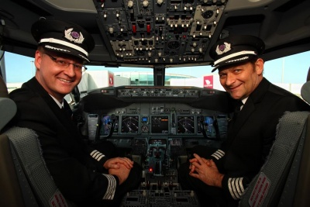
Characters
Main Character: Brian Robeson- a 13 year old boy who has divorced parents.
Minor Characters:
Brian’s Parents and 2 Unnamed Pilots

Slide 3
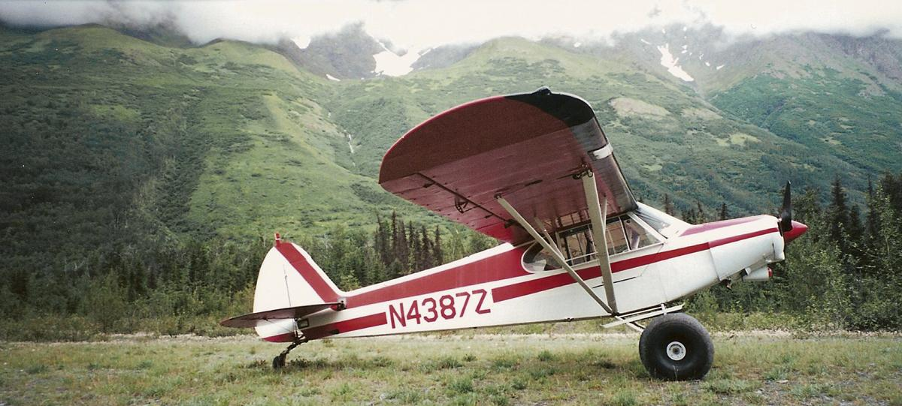
Exposition
The story starts out ……( you fill in the blank)
In the beginning, we learn that…._____
The background information you need to know is that……________

Slide 4
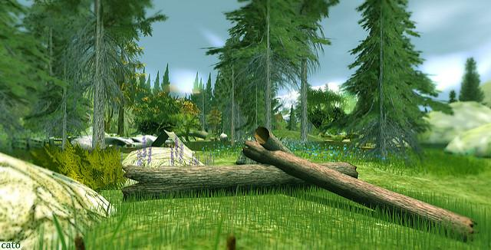
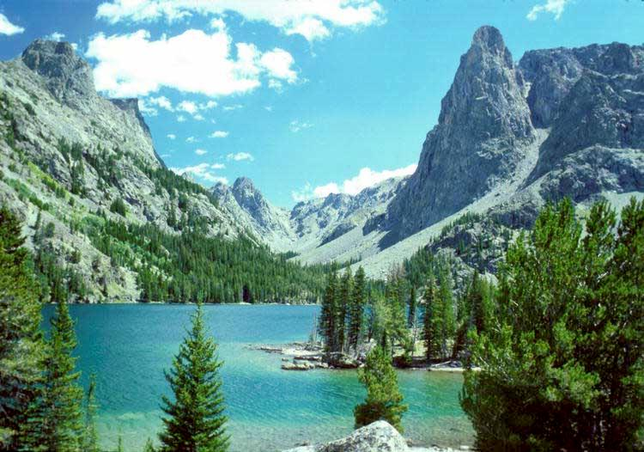
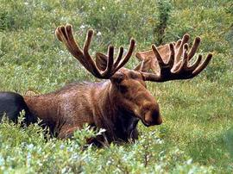
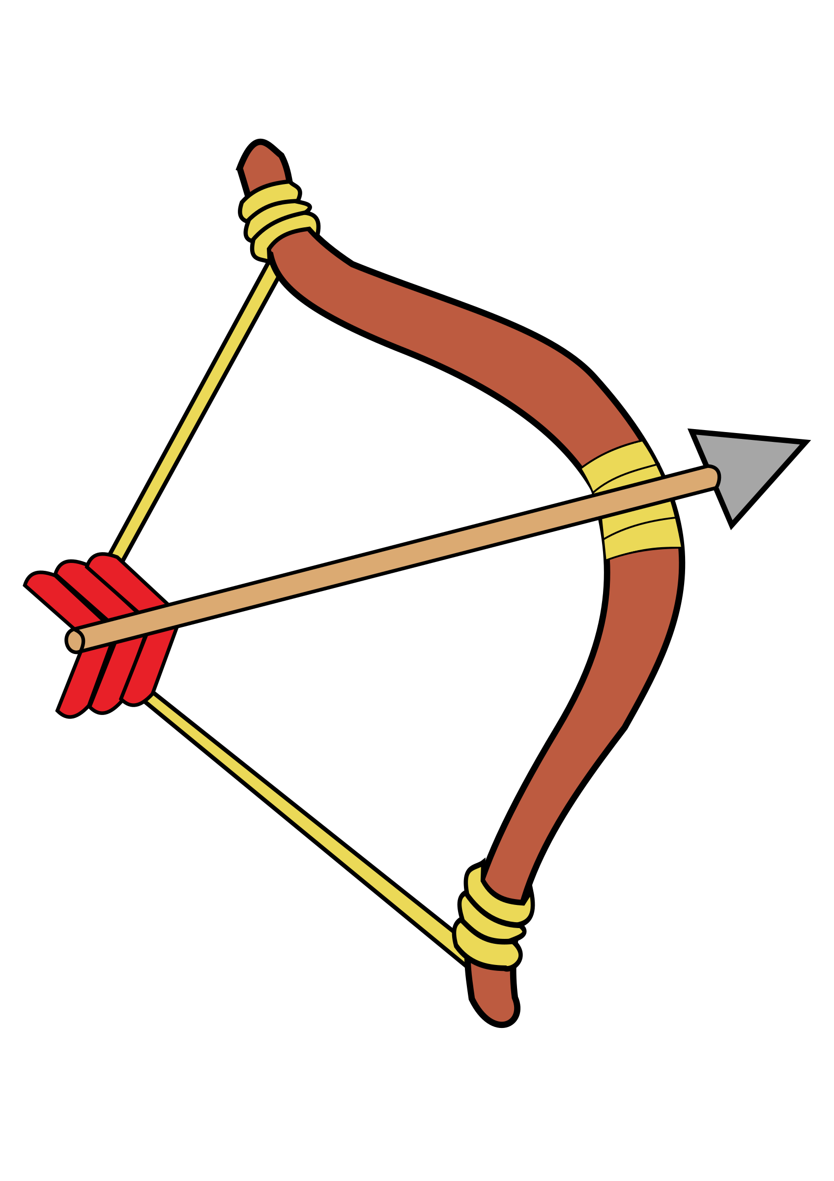
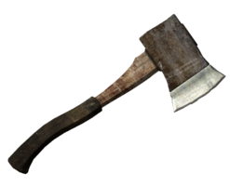
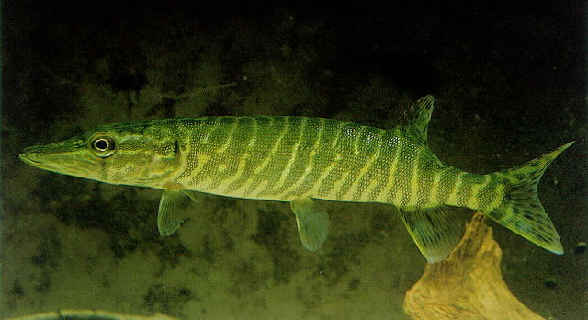
Rising Action
The story really kicks off when……
The problem gets worse when…..

Slide 5
Resolution
In the end, here’s what happens with Brian’s main problem ….

Slide 6
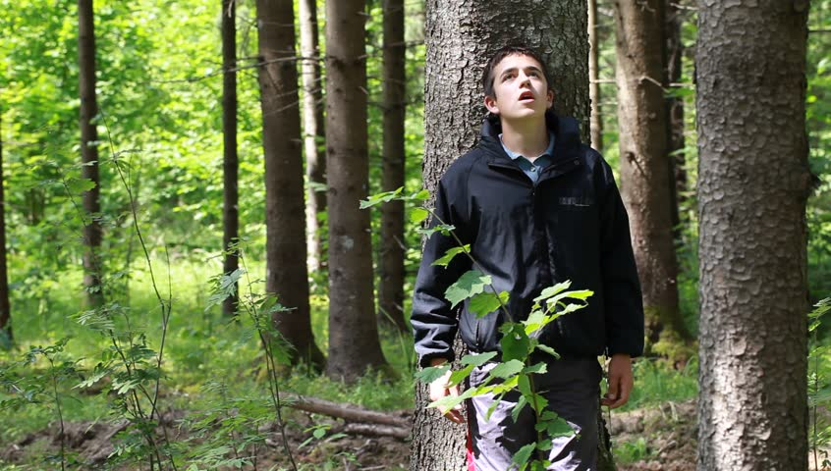
Main Conflict: Man vs. Nature
Man vs Self- inner conflict
“ I chose these conflicts because…”
( tell more about WHAT the conflict was and with whom)

Slide 7
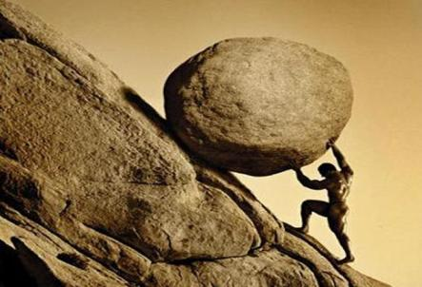
Themes
The Power of Positive Thinking
Perseverance and Grit
“ I chose these themes because I noticed the main character learned the following …..”

Slide 8
You can add additional titles ( just a little extra bonus slide) if your novel has sequels or is part of a series.
Not required.

Slide 9
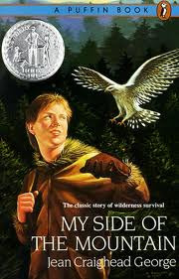
Related Books/Authors

Slide 10
Meaningful Quote:
Brian Robeson:
“But there is a difference now, he thought- there really is a difference. I might be hit but I’m not done. When the light comes I’ll start to rebuild. I still have the hatchet and that’s all I had in the first place.” ― Gary Paulsen, Hatchet
I chose this quote because…..

