Slide 1


http://phs.princetonk12.org/teachers/kcarney/EnglishII/032FB1B5-000F50D3.0/1114201351348_SignpostsfromNoticeNotereview.pptx.
Notice and Note: Close Reading Strategy
Anchor Charts / Handouts
(Color Coded with Symbols)
Contrasts and Contradictions, Aha Moment, Tough Questions, Words from the Wiser, Again and Again, Memory Moment
?
http://www.robbinsville.k12.nj.us/cms/lib07/NJ01000044/Centricity/Domain/296/Note_and_Notice_Newest_PPT.pptx.

Slide 2
What do good readers do?
Good readers are alert to the signposts that authors provide because they know that authors put everything in books on purpose.
When they see those signposts in their reading, they STOP, take NOTICE, and make a NOTE.
Because of this, they understand what they read better, AND…
…they understand and appreciate the author’s craft as a writer.

Slide 3
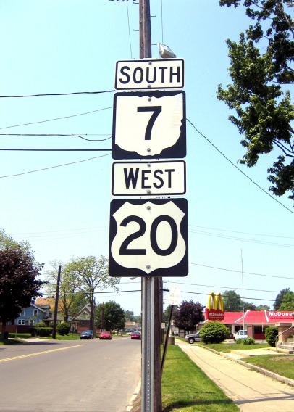
Authors provide signposts, too!
Why do authors provide signposts? For the same reason drivers need signposts --- to help you find your way...
We are going to learn about 6 signposts authors provide and what we can learn from each of them.

Slide 4
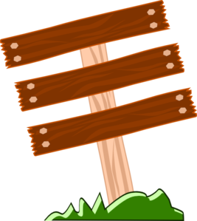
“Signposts”
Contrasts & Contradictions
“AHA” Moments
These “markers” can help guide you along the path to understanding as you read fiction. When you notice them,
and take note!
Tough Questions
Words from the Wiser
Again & Again
These are in order based on the signposts you will see more often to the ones you will see less often.
Memory Moments

Slide 5

Stop and Notice and Note
Contrasts &
Contradictions
When you’re reading and a character says or does something that’s opposite (contradicts) what he has been saying or doing all along,
You should stop and ask yourself:
“Why is the character doing that?”
This question encourages thinking about and discussing:
    Character, Motivation, Situation, Theme
The answers could help you make a prediction or make an inference about the plot and conflict.

Slide 6
Contrasts and Contradictions
When authors show us something that doesn’t fit with what we expect, when they present us with a contrast or a contradiction.
We want to pause and ask ourselves one question: Why would the character act this way?

Slide 7
Picture Book/Video
Activity
Introduction to the Disney movie “Tangled”
https://www.youtube.com/watch?v=EhSVreVsjJo
Rapunzel-Character Traits
https://www.youtube.com/watch?v=Loo41xVIb_I
http://www.youtube.com/watch?v=jlb0D9YHR7Y
As you watch the clips from Tangled, look for places where a character’s actions surprise you based on what you’ve learned about them in the beginning of the story.
Whenever this contradiction occurs make a note about who is making the contradiction and why you think they aren’t acting the way they usually act.

Slide 8
Stop and Notice and Note
When you’re reading and suddenly a character realizes, understands, or finally figures something out,
You should stop and ask yourself:
“How might this change things?”
If the character figured out a problem, you probably just learned something about the conflict.
If the character understood a life lesson, you probably just learned the theme.
“AHA” Moment

Slide 9
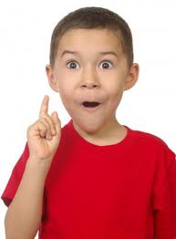
Aha Moment
Aha Moments are moments when a character realizes something, and that realization will probably change his or her actions in some way.
Clues that an Aha Moment is coming:
“Suddenly I realized…”
“In an instant I saw…”
“It came to me in a flash…”
“I finally understood that…”

Slide 10
Picture Book/Video
Activity
Rapunzel’s Realization
https://www.youtube.com/watch?v=jlb0D9YHR7Y
As you watch the clip from Tangled, think about a part in the story where the character finally realizes something and it changes the way they look at things.
Write down the Aha Moment and explain in your notes why it was an Aha Moment and what you learned from this moment. Did it change anything in the story?

Slide 11
Stop and Notice and Note
When you’re reading and the character asks himself a really difficult question,
You should stop and ask yourself:
“What does this question make me wonder about?”
You will learn about a character’s INTERNAL CONFLICT.
The answers will tell about the conflict and might give you ideas about what will happen later in the story.
Tough Questions
?

Slide 12
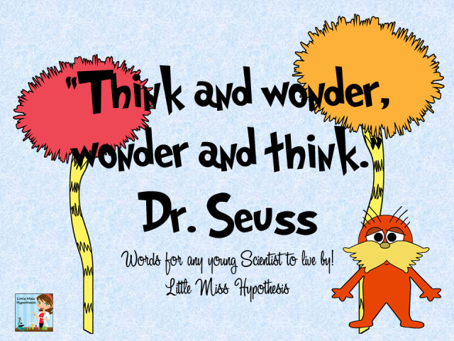
Tough Questions
When you’re reading and the character asks himself a really difficult question…
We want to pause and ask ourselves one question: “What does this question make me wonder about?”

Slide 13

Tough Questions: Activity
Watch the short animated film entitled, “Cooler Self”
http://www.youtube.com/watch?v=TFhLU7ULTtA
What is the tough question the character asks himself? What does that question make you wonder about him and his life?
(Remember that the answer will tell you about the conflict.)
What is the conflict in the story?
What do you think will happen later in the story?

Slide 14
Stop and Notice and Note
When you’re reading and a character (who’s probably older and wiser) takes the main character aside and gives serious advice,
You should stop and ask yourself:
“What’s the life lesson, and how might it affect the character?”
Whatever the lesson is, you’ve probably found a theme for the story.
Words from the Wiser

Slide 15
Words to the Wiser
Yoda’s Advice to Luke in the movie “Star Wars”
https://www.youtube.com/watch?v=E4hb7NcrJzQ
What is the life lesson being taught?
How does this affect the protagonist?
How does this help the reader understand the theme?

Slide 16
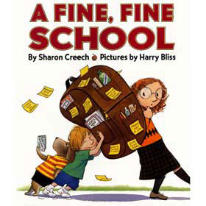
Words To The Wiser
Picture Book: A Fine, Fine School
https://www.youtube.com/watch?v=GecPV4iOpLQ
What is unique about this example of “Words of the Wiser”?
What is the life lesson being taught?
Could this also be the theme?

Slide 17

Stop and Notice and Note
When you’re reading and you notice a word, phrase, object, or situation mentioned over and over,
You should stop and ask yourself:
“Why does this keep showing up again and again?”
The answers will tell you about the theme and conflict, or they might foreshadow what will happen later.
Again and Again

Slide 18
Again and Again Activity
Read the text entitled, “Eleven” by Sandra Cisneros
Make a list of all the words or phrases that are repeated.
Next, ask yourself, “Why does this keep showing up again and again?”
What does that tell you about the theme of the text?

Slide 19

Stop and Notice and Note
When you’re reading and the author interrupts the action to tell you a memory,
You should stop and ask yourself:
“Why might this memory be important?”
The answers will tell you about the theme, conflict, or might foreshadow what will happen later in the story.
Memory Moment

Slide 20
Memory Moment
Read the text entitled, “Eleven” by Sandra Cisneros
What is the memory moment from “Eleven”
Explain in detail why you think that memory is important to the story.
Does this help you form a theme for the story?

